Slide 1




ISA 419: Data-Driven Security
01: Introduction to Cybersecurity
Fadel M. Megahed, PhD
Professor
Farmer School of Business Miami University
@FadelMegahed fmegahed fmegahed@miamioh.edu
Automated Scheduler for Office Hours
Spring 2025

Slide 2
Learning Objectives for Today's Class
Define information security (Infosec), its main goals, and how it fits within a firm’s overall security protocols
Describe the three main steps in information security: prevention, detection, and response.
Explain why prevention as a sole security measure is deemed to fail.
Describe course structure, goals, and overview.
2 / 37

Slide 3
IInnffoorrmmaattiioonn SSeeccuurriittyy && iittss MMaaiinn GGooaallss
33 // 3377

Slide 4
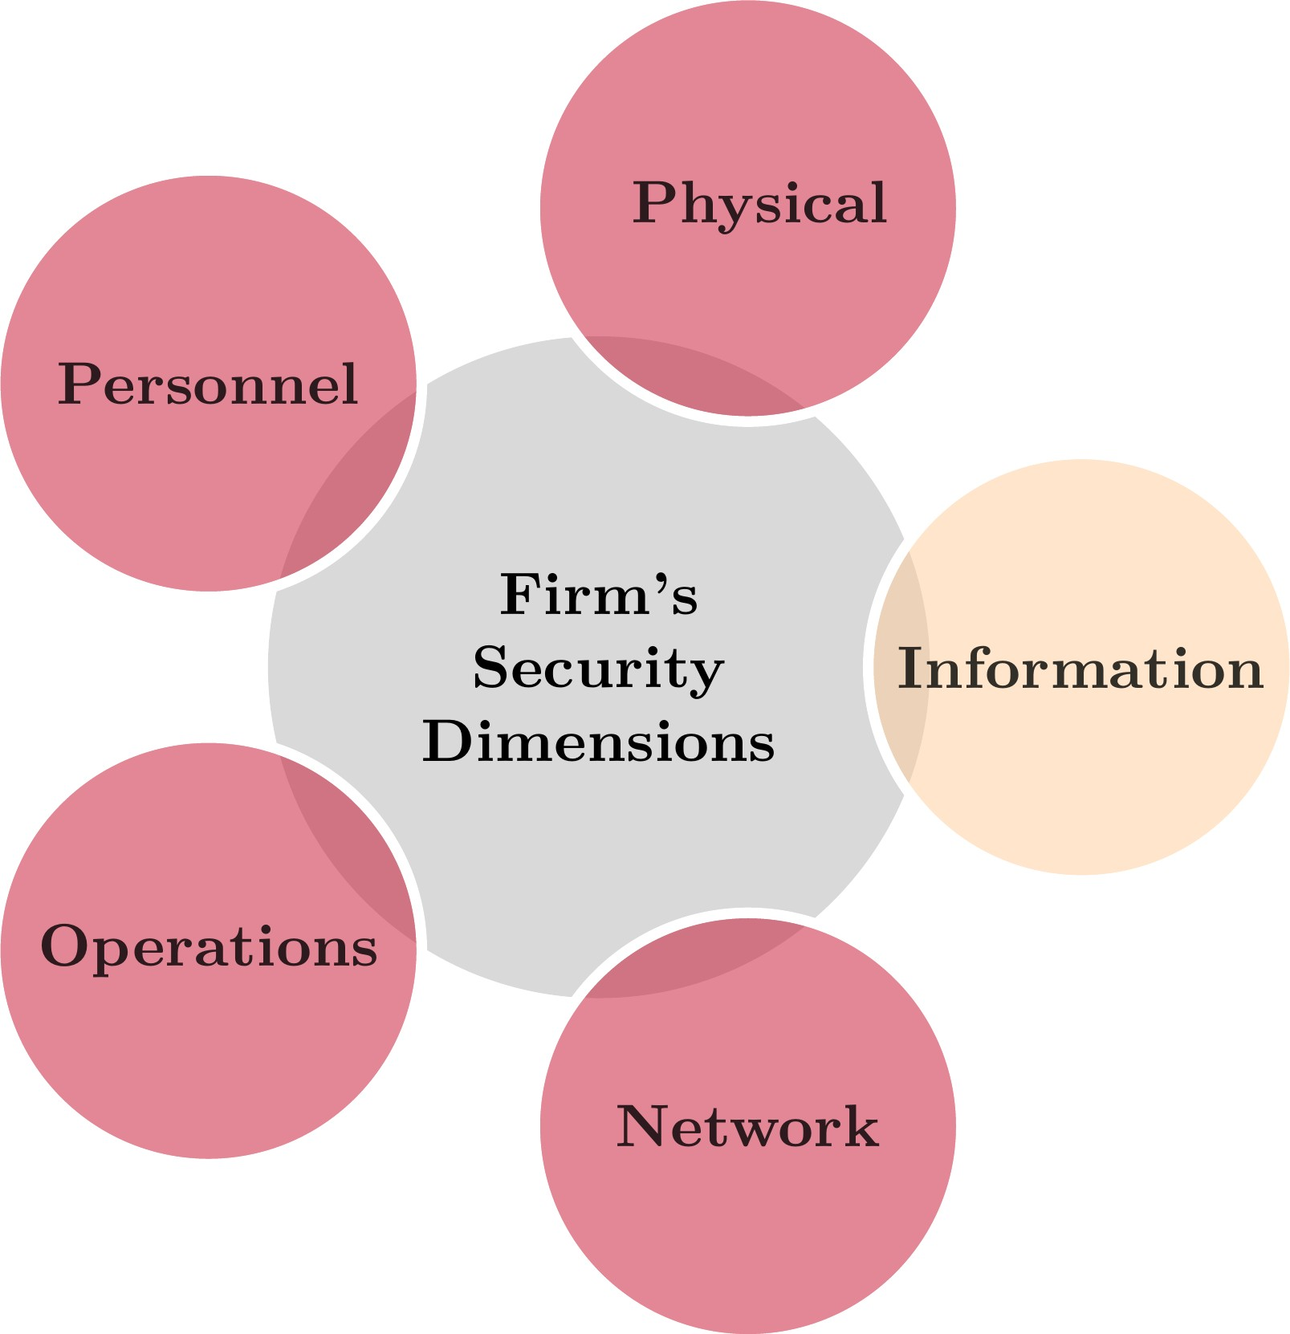
What is Security?
Some Working Definitions
According to the Merriam-Webster Dictionary, security can be defined as: "the quality or state of being secure: such as freedom from danger."
I.e., the objective is to protect against adversaries who would do harm whether it is intentional or not.
For example, national security is a multilayered system that protects the sovereignty of a state, its assets, its resources, and its people.'' (Whitman and Mattford, 2022, p. 8)
Security in Modern Organizations
Integrating InfoSec within the Broader Spectrum of Firm's Security Dimensions

Slide 5
What is Cyber/Information Security?
While some researchers distinguish between them, in this course, we will use both terms
interchangeably. Possible definitions for cyber/information security include:
According to the Merriam-Webster Dictionary, cyber security can be defined as: “measures taken to protect a computer or computer system (as on the Internet) against unauthorized access or attack.”
According to the SANS Institute, “information security refers to the processes and methodologies which are designed and implemented to protect print, electronic, or any other form of confidential, private and sensitive information or data from unauthorized access, use, misuse, disclosure, destruction, modification, or disruption."

Slide 6
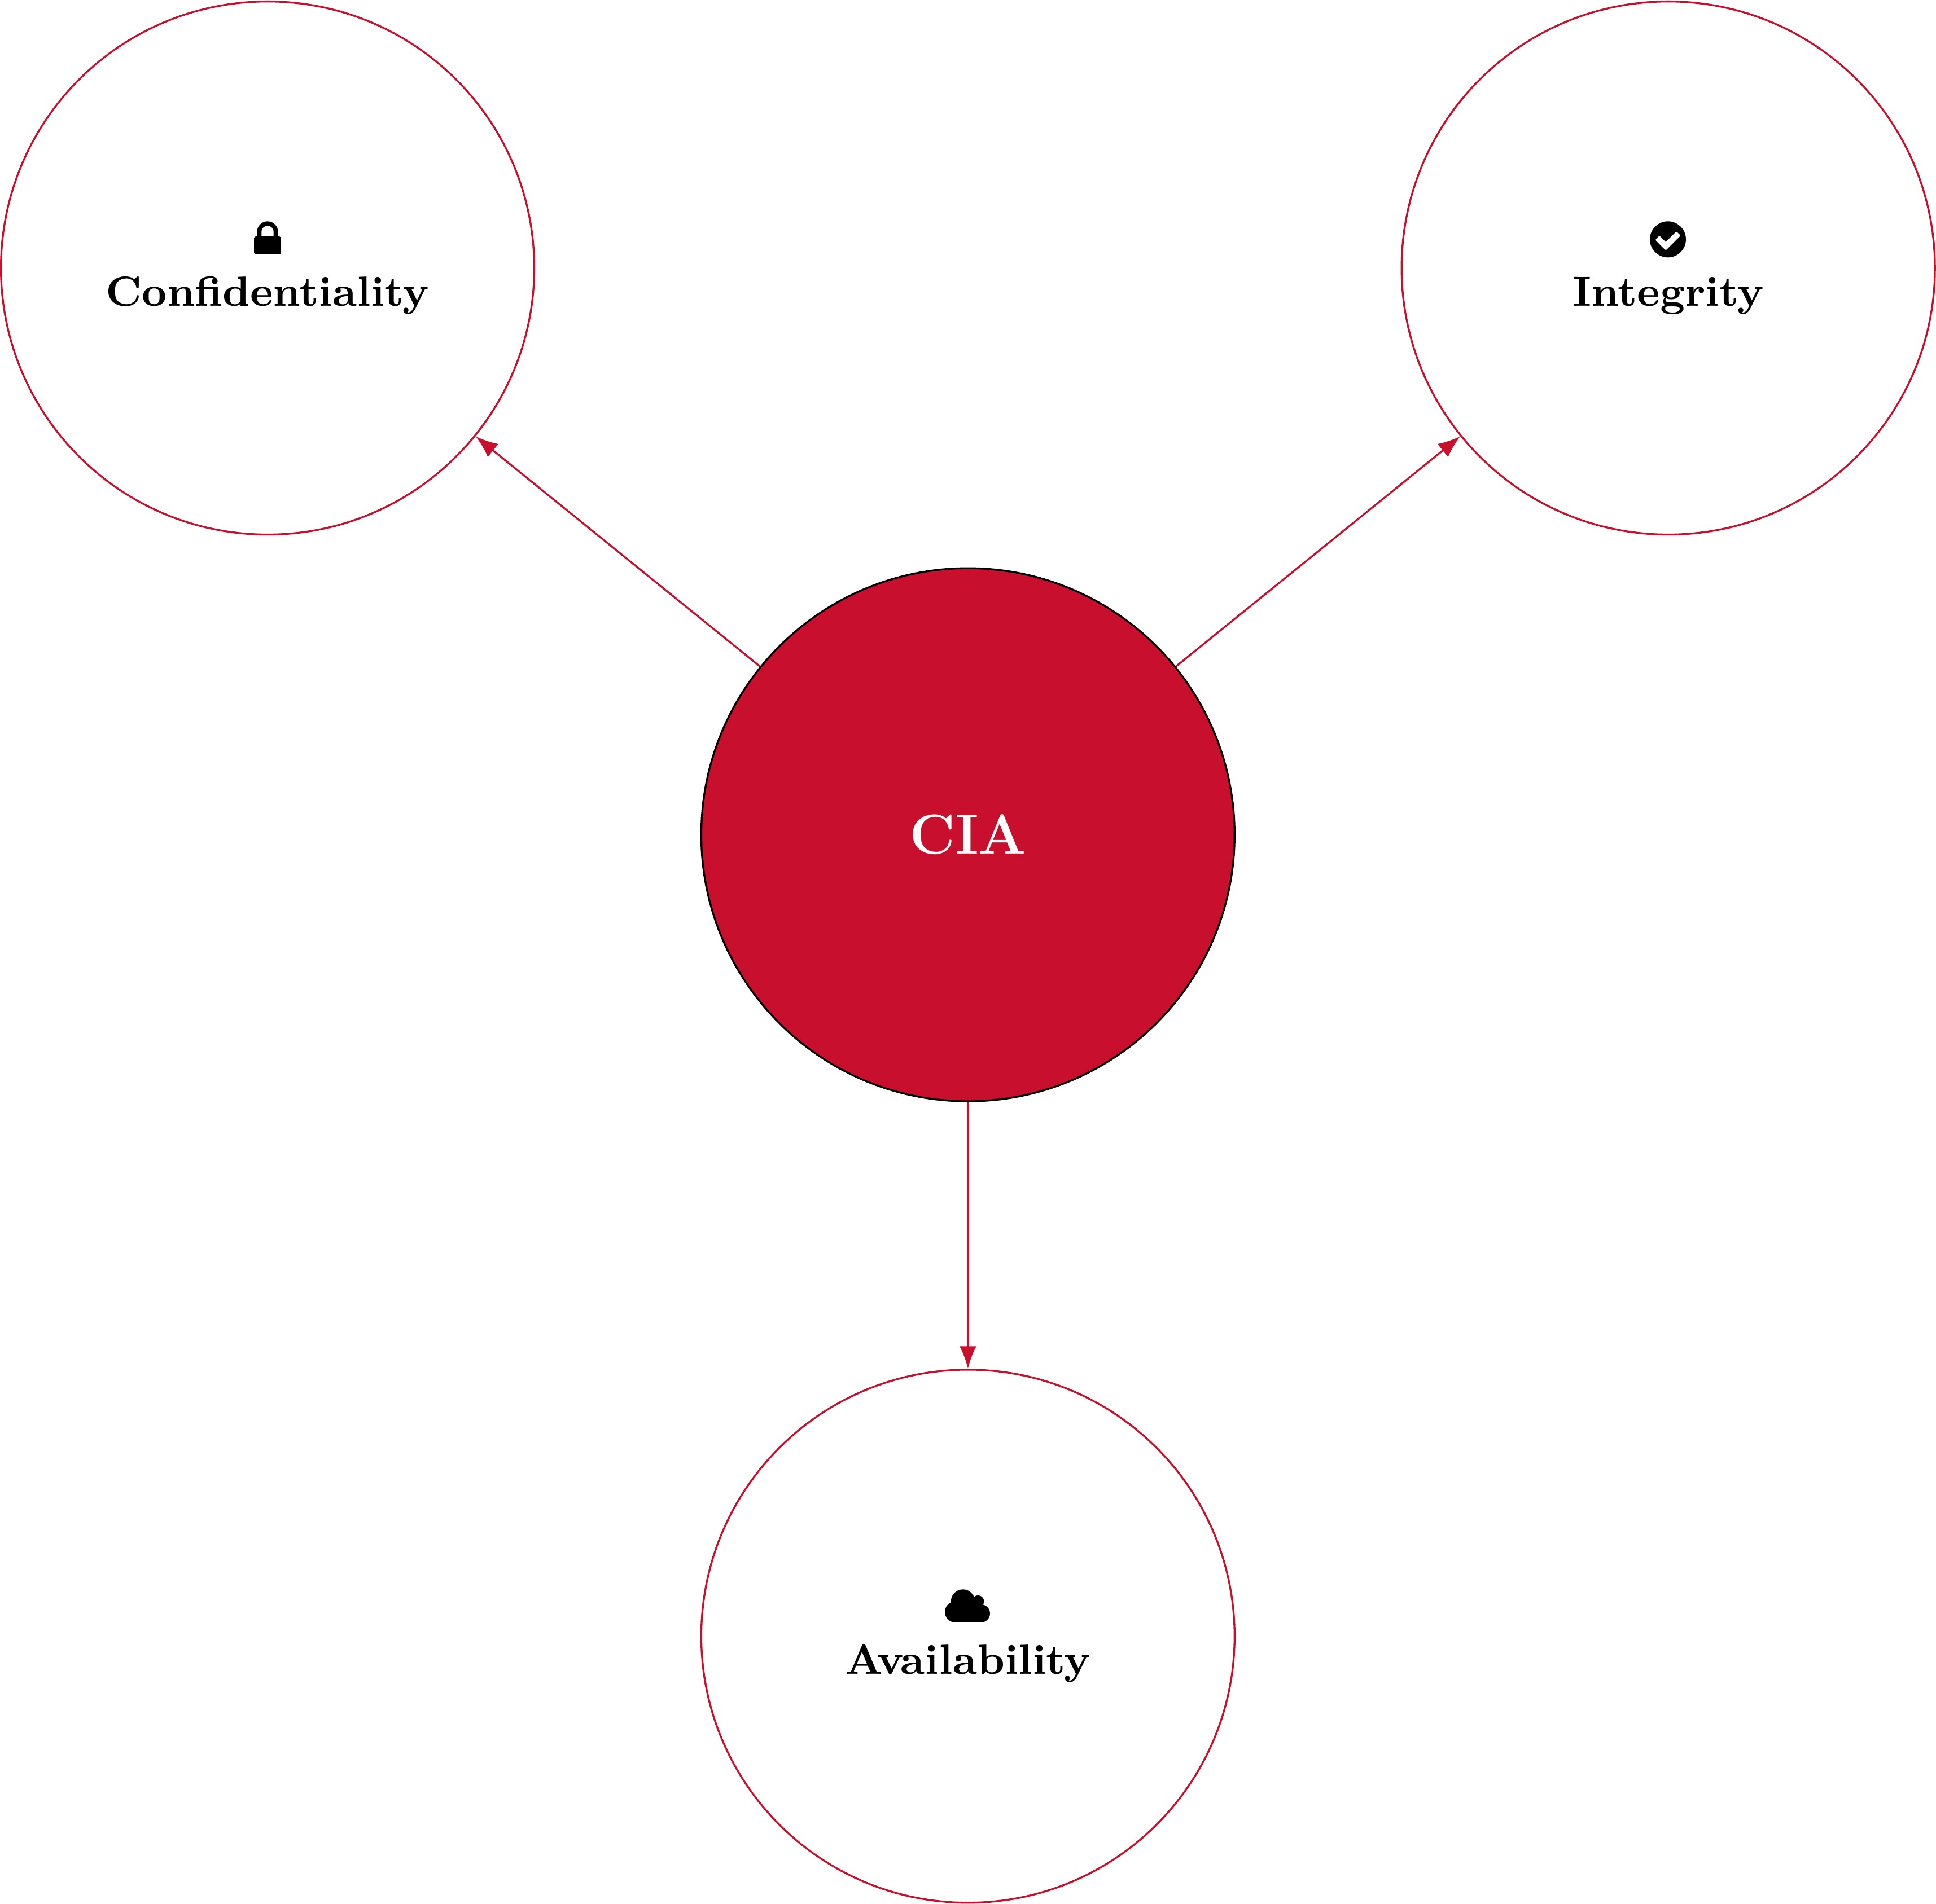
Information Security Goals
The CIA Triad:
Confidentiality: Preventing unauthorized reading/disclosure of information.
Integrity: Preventing unauthorized modification of information.
Availability: Preventing unauthorized withholding of information/ resources
The Interconnected Core of Cybersecurity: CIA Principles in Focus.

Slide 7



07:00
Class Activity: Explaining the CIA Triad
Activity Your Solution
Suppose that I would like to start an online banking business, named Miami University Online Bank (MUOB). Assume that we have:
Fadel (Owner) John McClane (Client) Hans Gruber (Bad Guy)
Your task: "Think-Pair-Share activity" Reflect individually, then discuss with your partner to finalize your explanation of the CIA principles in the MUOB context. Write it down in 2nd panel.

Slide 8
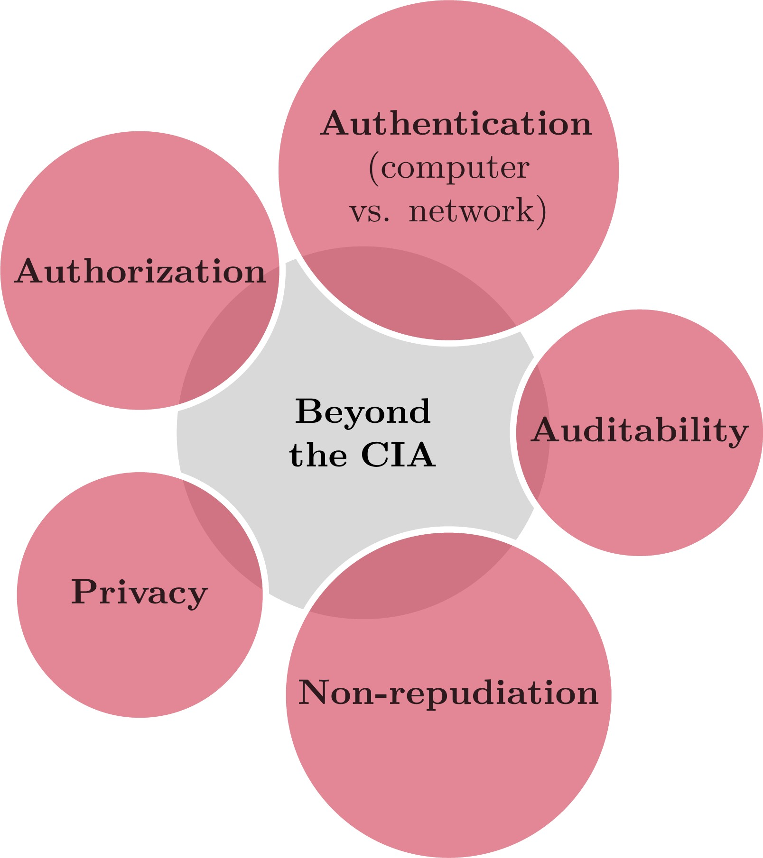
Beyond the CIA: Other InfoSec Objectives

Slide 9
Risk Management Controls
Effective cybersecurity begins with implementing diverse risk management controls, each targeting specific security aspects:
Administrative: Includes the development and deployment of policies and procedures; for example:
Password policies
Principal of least privilege (POLP)
Physical: In addition to securing a firm’s premises through doors/locks/etc., typical risk management controls utilize the:
Principal of separation of duties

Slide 10
Protocols, Host-Based Protections, and Other Key Preventive Measures
Protocols: For example, the reliance on secure socket layer (SSL) to authenticate the web source
Host-based protections: secure operating systems and/or patching
Access Control: Through identification (username), authentication (over a computer/ network), and authorization (file permissions, need-to-know principle)
Firewalls: to control inter-network traffic (e.g., from/to internet)
Security by design: code reviews, unit testing, defense in depth, and principle of least privilege

Slide 11
02:00
Class Activity: Have you been Pwned?
The purpose of this class activity is to investigate how many of your web accounts have been breached. This activity consists of the following steps:
Go to https://haveibeenpwned.com/
Insert the email you use most online (e.g., in my case it is my Gmail) into the search bar and then click on "pwned?"
Record the count of breaches that you were pwned in.
Anonymously, report the count of your breaches on the survey site (you will need to include the access code shown in class).
Outside of class: Address the breaches by changing your password for these sites, opting into 2-factor authentication, and changing the passwords in other websites (if you re-used this password).

Slide 12
Class Activity: Have you been Pwned? (Cont.)
ny data breaches have you been involved in, per h ttps://haveibeenpwned.com/ ?
0 |  | 0 |  | 0 |  | 0
1-2 |  | 3-5 |  | 6-10 |  | 11+

Slide 13
PPrreevveennttiioonn aass aa SSoollee SSeeccuurriittyy MMeeaassuurree iiss DDeeeemmeedd ttoo FFaaiill
1133 // 3377

Slide 14
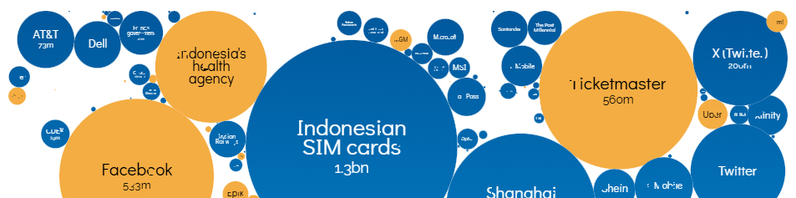
Failure of Prevention: World’s Biggest Data Breaches
N 

Neeww!! LLeeaarrnnttoo ddoo ddaattaa--vviizz wwiitthh oouurr oonnlliinnee sseemmiinnaarrss..
Find Out More
World's Biggest Data Breaches & Hacks
Selected events over 30,000 records stolen
UPDATED: Jun 2024
interesting story
size: records lost
filter
search...
2024
2022

Slide 15
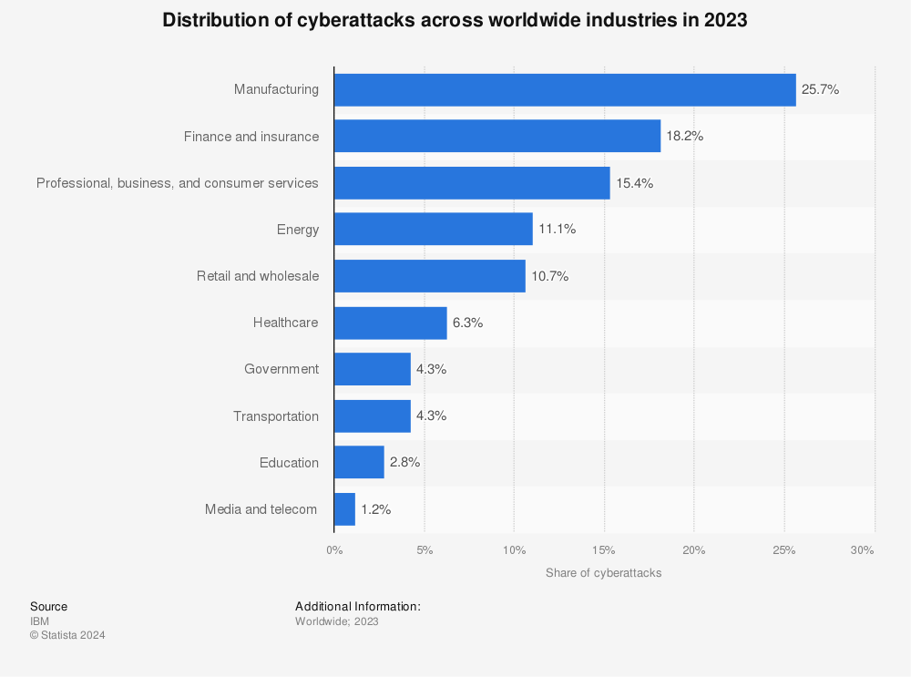
Failure of Prevention: World's Most Targeted Industries

Slide 16
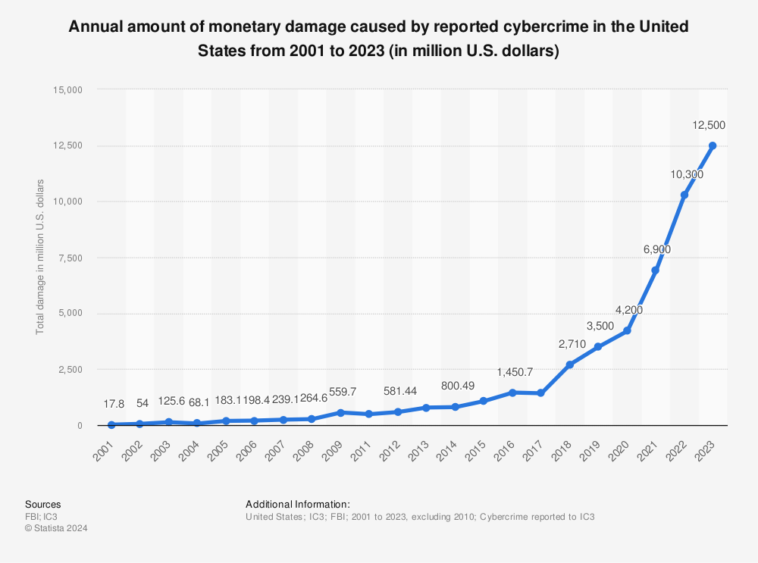
Failure of Prevention: Monetary Damage in the U.S.

Slide 17
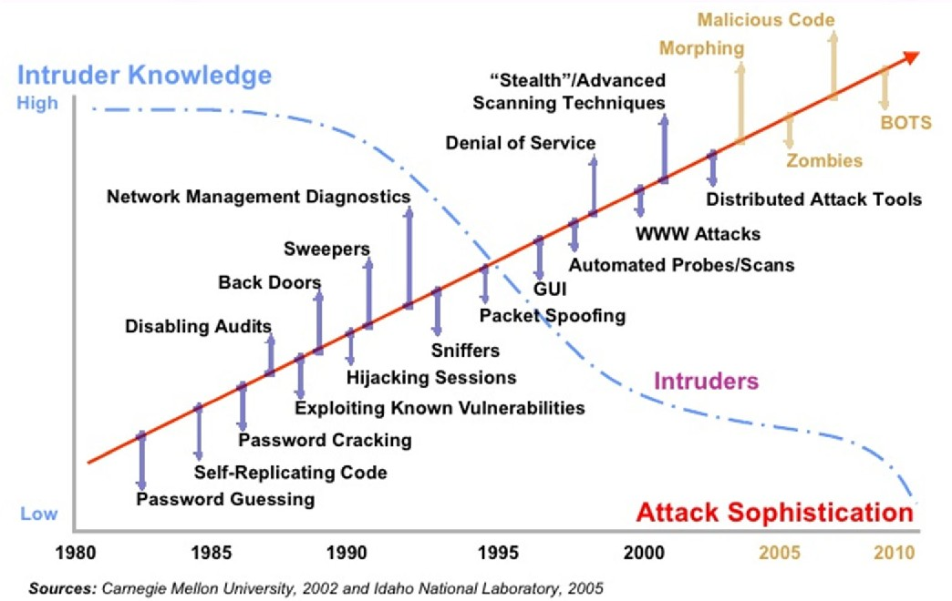
Failure of Prevention: Attacks Constantly Getting Easier
Attack sophistication versus intruder technical knowledge
Source: Ramirez, J. H. P. (2017). An Anomaly Behavior Analysis Methodology for the Internet of Things: Design, Analysis, and Evaluation (Doctoral dissertation, The University of Arizona).

Slide 18
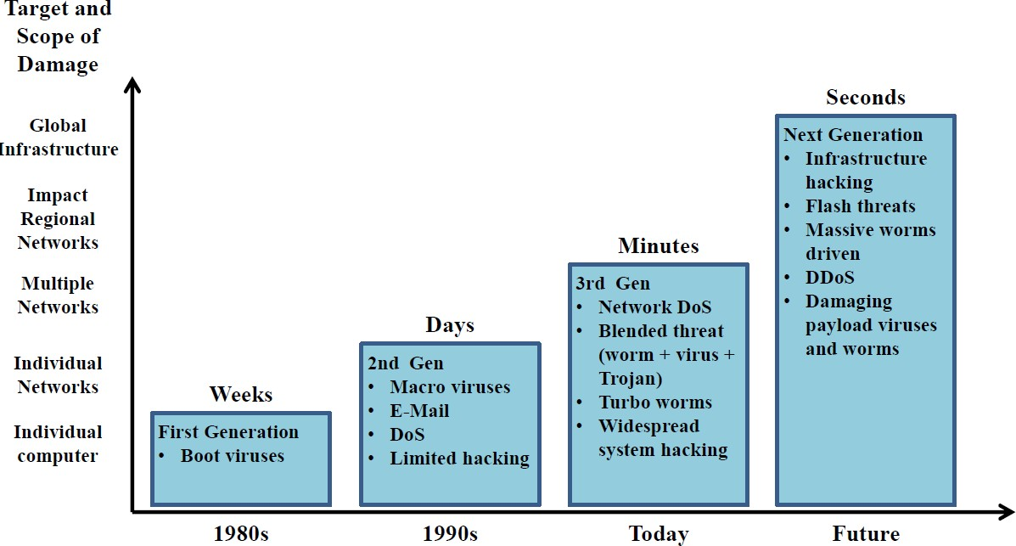
Failure of Prevention: Attacks Constantly Getting Faster
The timeline of cyber-threads scope of damage and impact time
Source: Ramirez, J. H. P. (2017). An Anomaly Behavior Analysis Methodology for the Internet of Things: Design, Analysis, and Evaluation (Doctoral dissertation, The University of Arizona).

Slide 19
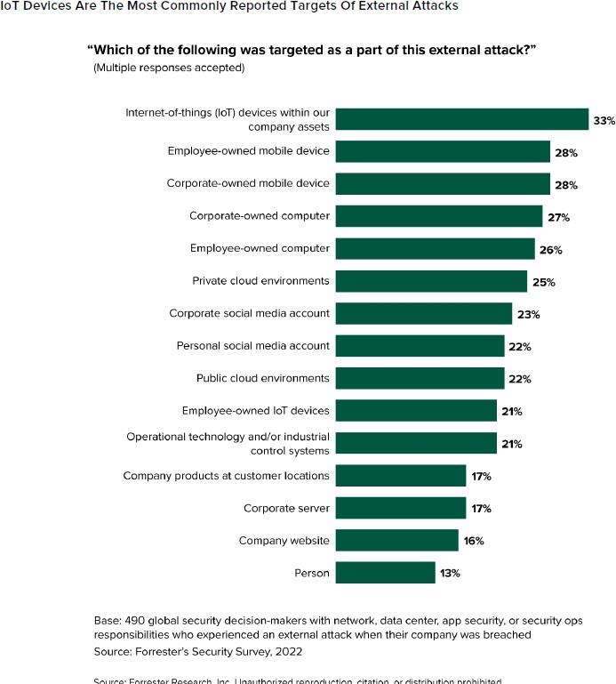
Failure of Prevention: Attackers Having More Options
Source: Louis Columbus (2023). Why attackers love to target IoT devices. VentureBeat.
19 / 37

Slide 20
Why is Prevention Not Enough?
Inherent weaknesses in increasingly more complex systems/networks
Poor Design
Software and hardware
Example: sendmail (race condition vulnerability, buffer overflow, group permission vulnerability, etc.)
Poor Implementation
Security an afterthought
Lack of personnel experience/training
Poor system configuration (e.g., default firewall configurations with open insecure ports)
Poor Management
Inadequate policies/procedures
20 / 37

Slide 21
Why is Prevention Not Enough?
Tradeoff between security and usability
Cost of prevention
Source: Adapted from CS 259D, Stanford University, https://web.stanford.edu/class/cs259d/lectures/Session1.pdf
21 / 37

Slide 22
TThhee TThhrreeee MMaaiinn SStteeppss iinn IInnffoorrmmaattiioonn SSeeccuurriittyy ((DDeeffeennssee))
2222 // 3377

Slide 23
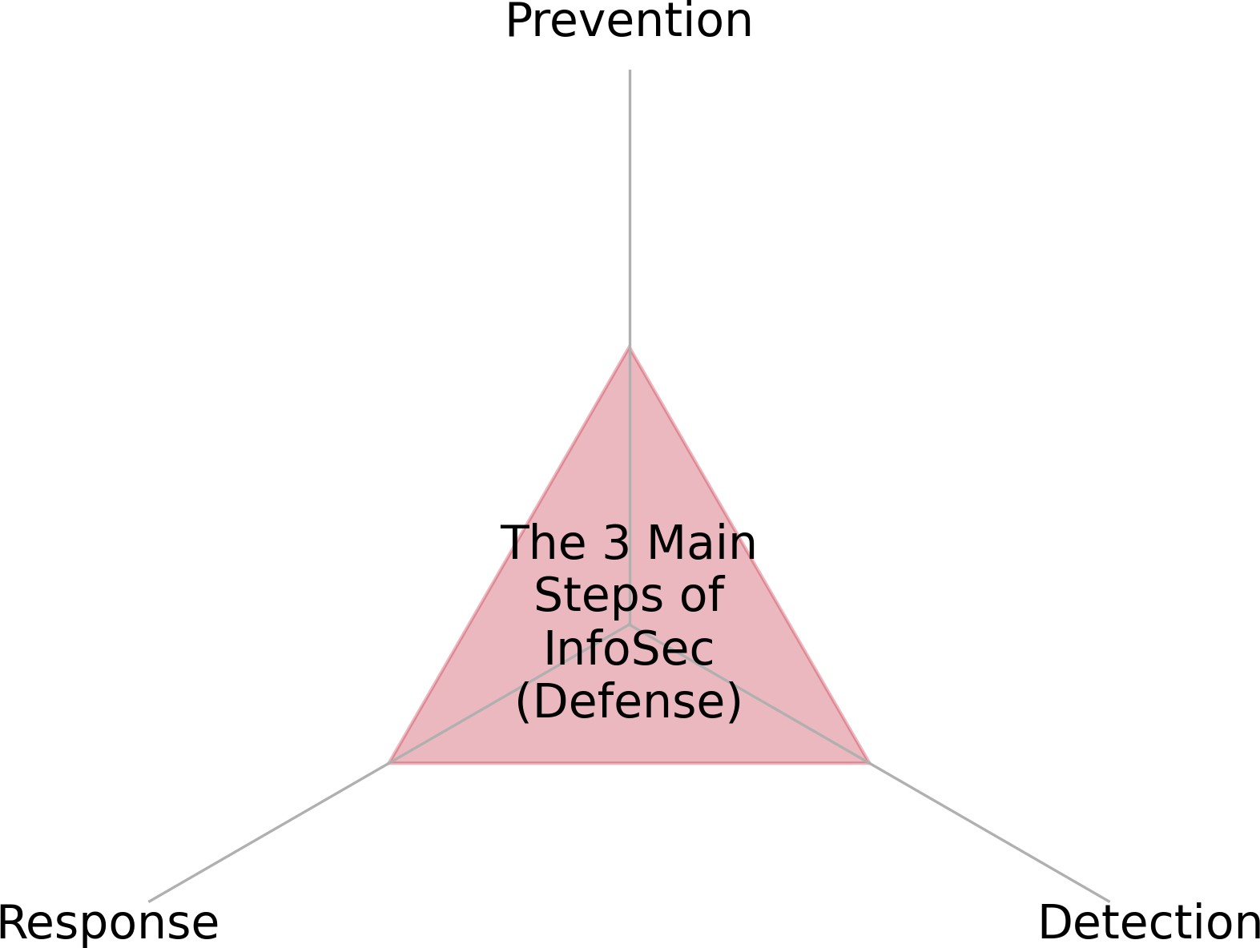
A Taxonomy of Information Security Measures
23 / 37

Slide 24
CCoouurrssee DDeessiiggnn,, EExxppeeccttaattiioonnss,, aanndd OOvveerrvviieeww
2244 // 3377

Slide 25
Course Overview
Traditionally, information technology (IT) security was a job that entailed using a few tools, solutions and best practices that focused on attack prevention and protect a company’s sensitive information and network assets. However, these solutions are no longer sufficient. The businesses are transitioning to a new era, where cybersecurity is enhanced and almost always requires data-driven analytical solutions. The primarily goals of data-driven security are to:
discover malicious patterns from the data-lakes of logs produced by security software, and
develop automated tools that can assist in the surveillance of security-related data.
This course covers various analytic applications in information/cyber security including: user behavior analysis, network and host intrusion detection, web security, phishing detection, and emerging issues in Industrial Internet of Things (IIoT) security. Note that the course is designed to be very applied, involving a large amount of programming to examine real datasets.

Slide 26
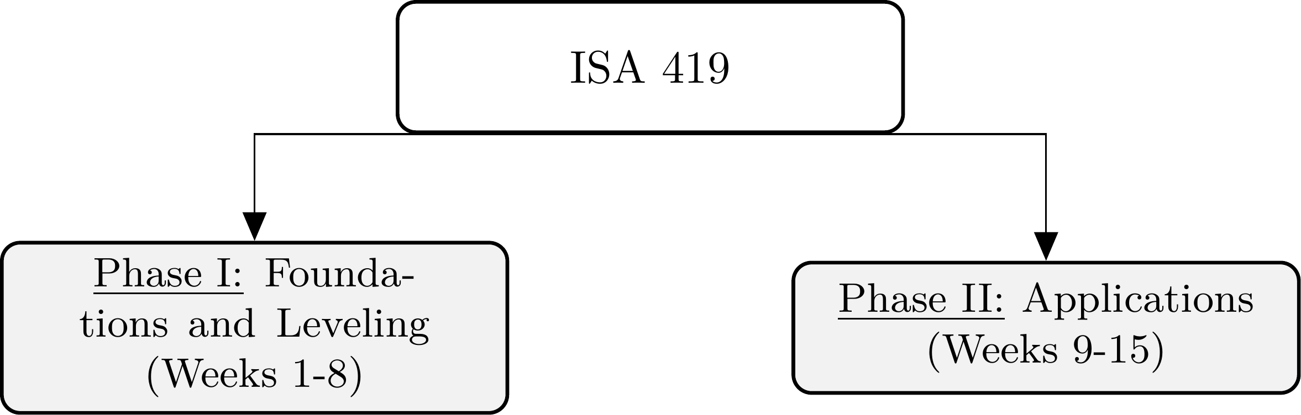
Course Overview
How the ISA 419 course is organized.

Slide 27
Course Objectives
Upon completing the course, you will:
Describe key cybersecurity concepts, including the CIA Triad, access management, incident response, and common cybersecurity best practices.
Demonstrate a fundamental understanding of the role of analytical solutions in state-of-the- art cybersecurity solutions.
Understand the uniqueness of cybersecurity datasets, including the nature of unbalanced data and diversity of data in each class, asymmetrical costs of misclassification, and non- stationary inference.
Understand the theory behind some commonly used statistical methodologies and machine learning algorithms in data-driven security.
Use and implement an appropriate modeling paradigm to tackle cybersecurity problems.

Slide 28
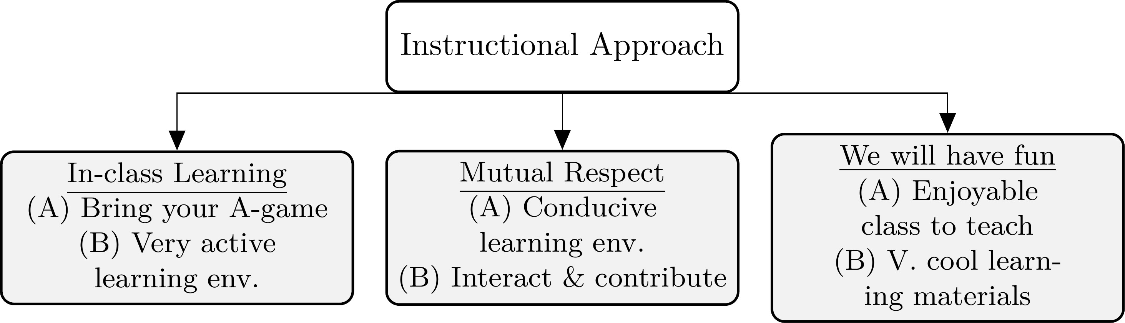
Instructional Approach
An overview of the instructional approach for ISA 419.

Slide 29
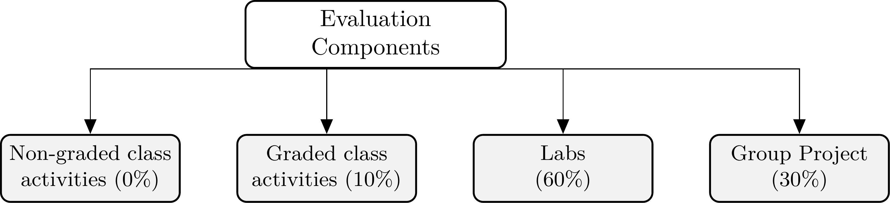
How will I Evaluate your Learning?
An overview of the evaluation components for ISA 419.

Slide 30
TThhee EEqquuiiffaaxx DDaattaa BBrreeaacchh:: AA CCaassee SSttuuddyy
3300 // 3377

Slide 31
Case Background
Equifax Overview:
Major credit reporting agency.
Manages sensitive personal data of millions.
The Breach Discovery:
Disclosed in September 2017.
Compromised personal information of 147 million individuals.
Vulnerability Exploited:
Apache Struts CVE-2017-5638.
Equifax's system was unpatched.

Slide 32
Case Background (Cont.)
Breach Timeline:
Apache reported the vulnerability in March 2017.
Equifax’s systems remained vulnerable for months.
Unauthorized access occurred from May to July 2017.
Data Compromised:
Included names, Social Security numbers, birth dates.
Addresses, and in some cases, driver's license numbers and credit card numbers.

Slide 33
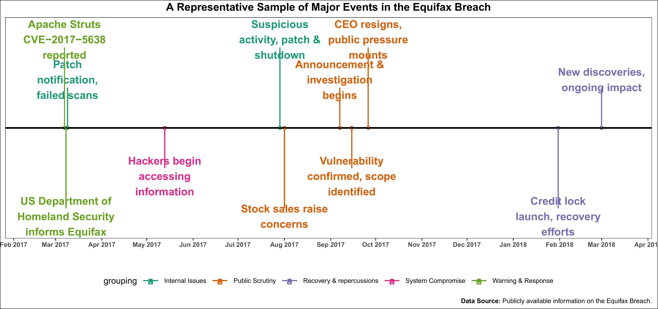
The Detailed Timeline of the Equifax Data Breach

Slide 34
RReeccaapp
3344 // 3377

Slide 35
Summary of Main Points
By now, you should be able to do the following:
Define information security (Infosec), its main goals, and how it fits within a firm’s overall security protocols
Describe the three main steps in information security: prevention, detection, and response.
Explain why prevention as a sole security measure is deemed to fail.
Describe course structure, goals, and overview.

Slide 36
📝 Review and Clarification 📝
Class Notes: Take some time to revisit your class notes for key insights and concepts.
Zoom Recording: The recording of today's class will be made available on Canvas approximately 3-4 hours after the session ends.
Questions: Please don't hesitate to ask for clarification on any topics discussed in class. It's crucial not to let questions accumulate.

Slide 37
🎯 Assignment 🎯
In pairs, you are expected to do a deep dive on the case by reading the following sources:
Student 1: should read in detail the CSO Online article.
Student 2: should read in detail the archived artile from the EPIC report
You are both encouraged to explore any hyperlinks within both articles and take notes pertaining to the discussion questions below.
Discussion Questions
What was the Apache Struts CVE-2017-5638 vulnerability and its associated patch?
Discuss how the Equifax breach violated the principle of confidentiality.
what was the impact of the breach on Equifax's data integrity and service availability?
Evaluate Equifax's response strategy in terms of information security best practices.
Assignment Details and Submission
The assignment should be submitted on Canvas. See the assignment submission page for more details.

